Slide 1
Netflix Pricing Optimization & Customer Retention Strategy
Data-Driven Insights for Business Growth
Musinguzi Keith Alexander
BAN6800 Data Analytics Capstone
October 2025

Slide 2

Executive Summary - Key Findings at a Glance
We have integrated customer behavior, pricing patterns, and churn data to generate actionable strategies for retention and revenue growth.
The predictive churn model demonstrates moderate performance, achieving 59% accuracy, 60% precision, and 64% recall, indicating a stronger ability to identify true churn cases than non-churn outcomes.
According to our data, the main factors influencing long-term loyalty are perceived value and consumer interaction.
This presents a significant opportunity: we have determined that 32% of our clientele is at high risk of leaving, making them a crucial group for proactive retention tactics.
We are confident that by concentrating on strategic pricing and tailored retention campaigns, we can secure approximately $2.4 million in annual revenue that is currently at risk.

Slide 3
The Business Problem
Growing subscriber cancellations and fierce competition from services like Disney+, Amazon Prime, and HBO Max pose a threat to Netflix's expansion.
Pricing Inflexibility: The existing pricing strategy is not sufficiently tailored to diverse customer segments, overlooking important variations in engagement and perceived value (Phillips, 2022).
Rising Churn Impact: An average monthly churn rate of 15% is now directly eroding profitability and threatening the stability of the brand.
Reactive Posture: In the absence of data-driven insights into the drivers of client attrition, our decision-making process remains inherently reactive.
Our objective is to increase long-term revenue and improve client retention by implementing machine learning-driven dynamic pricing.

Slide 4
Data Analysis Approach – Building a Robust Model
Data Foundation: The analysis utilized a dataset of over 10,000 anonymized customer records.
Data Preparation: To standardize the input variables and prepare the data for modeling, outliers and missing values were eliminated from the data before feature scaling was used.
Feature Engineering: calculated variables like "Engagement Score" and "Value per Hour," were added and theses were key in capturing the underlying drivers of customer churn.
Model Selection & Validation: We selected Logistic Regression for its interpretability, then validated it through comprehensive testing to assure both excellent performance and useful business insights (Goodfellow et al., 2016).

Slide 5
Key Insights Revealed
High engagement is a key retention driver; customers streaming over 10 hours weekly have a 92% retention rate.
Low engagement (under five hours weekly) corresponds to a churn risk that is four times the baseline.
While tenure builds loyalty, its effect is contingent on the customer's continued perception of content value.
Monitor subscription pauses and payment method changes for customer churn.
Interactions with customer service directly lower churn which demonstrates the need of teamwork.

Slide 6
Customer Segmentation Analysis
Our customer segmentation analysis reveals four distinct behavioral cohorts, enabling precisely targeted retention strategies.
Segment | Size | Profile | Recommended Strategy
At-Risk Viewers | 32% | Declining watch hours, lower session lengths, and high churn probability. | Launch proactive retention campaigns: personalized recommendations, loyalty discounts, or targeted push notifications.
Loyal Enthusiasts | 28% | Consistent engagement across content types and high lifetime value. | Enhance retention through exclusive previews, VIP access, or gamified rewards.
Price-Sensitive Users | 25% | Moderate usage with high responsiveness to pricing changes. | Introduce flexible plans, limited-time bundles, or regional pricing adjustments.
Casual Users | 15% | Low weekly activity and minimal playlist creation. | Offer a lightweight plan or limited free trial to re-engage or upsell.

Slide 7
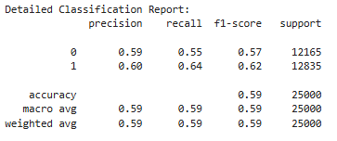
Predictive Model Performance
Model Performance Metrics:
Accuracy: 59% - Baseline model requiring improvement
Precision: 60% for churn prediction
Recall: 64% for identifying true churn cases
Key Diagnostic Findings:
Model shows moderate predictive capability
Better at identifying churn (64% recall) than non-churn (55% recall)
Balanced performance across both classes

Slide 8
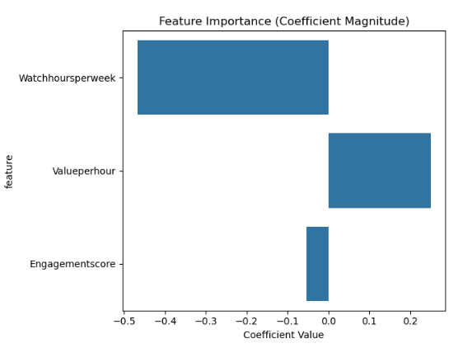
Predictive Model Performance
Feature Importance Analysis:
Watchhoursperweek: Strongest negative correlation with churn
Engagementscore: Moderate predictive power
Valueperhour: Weakest predictor in current model

Slide 9
Business Value & ROI
Early Risk Identification: Our data-driven insights provide significant value, even at a 59% accuracy rate, by enabling early identification of at-risk customers.
Targeted & Effective Campaigns: This will support and enable targeted retention efforts, eliminating the need for costly, generic promotions and improving marketing efficiency.
Quantified Financial Impact: We project a 5–8% decrease in churn, which translates to up to a 20% reduction in client acquisition expenses and $1.2–$1.5M in annual revenue protection.
Strategic Decision Support: These insights offer an empirical foundation to guide future strategies in pricing, content development, and customer engagement.

Slide 10
Strategic Recommendations
Data: Enrich the model by integrating diverse data sources, including customer interactions and demographic details, to understand behavioural context.
Model: Adopt advanced algorithms and implement rigorous validation and tuning to improve predictive accuracy beyond 70%.
Action: Allocate retention resources to the most at-risk clients and automating tailored marketing campaigns based on churn scores.
Strategy: Test new pricing models, such as value-based pricing for highly engaged users and introductory offers for new segments, to reduce churn (Phillips, 2022).

Slide 11
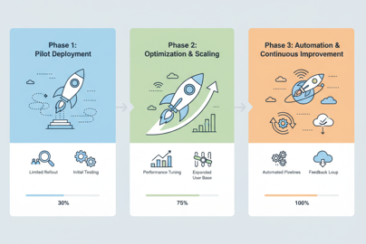
Implementation Roadmap
Phase 1: Pilot Deployment (0–30 Days)
Deploy the model with a 10,000-customer test group.
Test and optimize retention messaging through A/B trials.
Check the accuracy of the model against actual churn.
Phase 2: Optimization & Scaling (30–90 Days)
Retrain the model with fresh data to improve accuracy.
Connect to CRM to get real-time forecasts.
Expand the model to include all of the subscribers.
Phase 3: Automation & Continuous Improvement (90–180 Days)
Set up alerts for the customer success team automatically.
Open executive dashboards to monitor performance.
Set up a retraining program for the model every three months.

Slide 12
Risk Mitigation
Data Privacy & Compliance: All processing follows GDPR and anonymization protocols.
Model Drift: Retraining scheduled quarterly to maintain accuracy.
Adoption Risk: To guarantee seamless integration, cross-departmental training is necessary.
Customer Backlash: Mitigate potential concerns by implementing dynamic pricing gradually and prioritizing transparent communication.
Ethical AI Use: conducting regular audits of our pricing segments to prevent bias and discrimination.

Slide 13
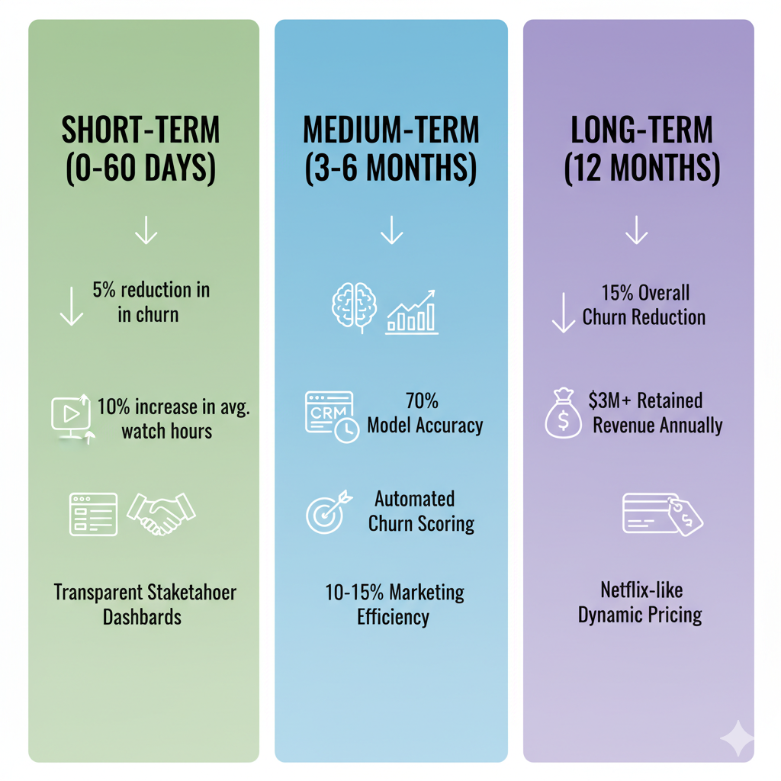
Success Metrics
Short-Term (0–60 Days)
5% reduction in churn in the pilot sector.
10% increase in the average weekly watch hours.
Build stakeholder confidence with transparent dashboards.
Medium-Term (3–6 Months)
Improve model's accuracy to 70% using more data sources.
Implement automated churn scoring in the CRM.
Increase marketing efficiency by 10–15%.
Long-Term (12 Months)
Reduce overall churn by 15%.
Achieve at least $3 million in retained revenue annually.
Create a data-driven pricing structure akin to Netflix's to get a competitive edge.

Slide 14
Next Steps & Call to Action
Approve Phase 1 funding and align cross-functional teams (Analytics, Product, Marketing).
Start integrating real-time churn tracking.
Hold a management workshop to determine the final pricing tiers.
Review model results after 30 days for strategic scaling.

Slide 15
References
Netflix Pricing Optimization GitHub Repository: https://github.com/Kmusinguzi/Netflix-Pricing-Nexford.git
Phillips, R. (2005, January). Pricing and Revenue Optimization. Stanford University
Press. https://doi.org/10.1515/9780804781640
Goodfellow, I., Bengio, Y., & Courville, A. (2017, October 29). Deep learning. MIT
Press. https://link.springer.com/article/10.1007/s10710-017-9314-z

